Slide 1

Web Development Project
Maulana Abul Kalam Azad
University Of Technology
➤ project members :-
1.Sumanta Bhattacharya Roll no:30001222180
2.Tushar Ghosh Roll no:30001222177
3.Sahana Mallick Roll no:30001222178
4.Sudipta Sasmal Roll no:30001222170
5.Moumita Mula Roll no:30001222166

Slide 2
Index:
Contents:
Introduction Page No: 3-4
Objectives Page No: 5
Advantages Page No: 6
Sections Page No: 7-9
Blog Application Snapshots Page No: 10-12
Software Engineering Model Used Page No: 13
Software Requirements Page No: 14
Hardware Requirements Page No: 15
Database Structure Page No: 16
Workflow Page No: 17
Conclusion Page No: 18

Slide 3
WHAT IS BLOG?
A blog (a truncation of "weblog") is a discussion or informational website published on the World Wide Web consisting of discrete, often informal diary-style text entries (posts).

Slide 4

INTRODUCTION
We have created a blog application using technologies such as React for the front end and Appwrite as the backend-as-a-service platform. Styling is done using both CSS and Tailwind (PostCSS). The application includes features like a navbar, footer and a button to toggle the sidebar on small devices (using JavaScript), allowing visitors to effortlessly explore our website and discover the stories behind each post.

Slide 5
OBJECTIVES
Manage user activity (register/login/logout)
Add/modify/delete blogs
Publishing and viewing the blogs on the site
User email verification

Slide 6
Advantages of the Proposed System
User friendly
Simple and fast
Low cost and effective
It deals with the collection of information
Provides security to the users

Slide 7
SECTIONS
Home:
The homepage serves as the welcoming gateway, featuring an engaging design that captures the essence of the blog application. It provides a brief overview of the structure of the site and includes a clear call-to-action to encourage users to explore further.
Tailwind CSS is employed to create a visually appealing and responsive design that adapts seamlessly to various devices, enhancing the user experience.
Consistent branding elements, color schemes, and typography are implemented across all sections to maintain a cohesive and professional look. This project showcases the power of React and Tailwind CSS in creating an aesthetically pleasing and functional online presence for our blog application.
Design Approach:

Slide 8
SECTIONS
Post Feed:
Displays a curated list of blog posts in an organized and responsive layout, with preview images, titles, and short descriptions to encourage click-through and exploration.
Provides a detailed view of each blog post with full content, author info, and interactive elements such as comments, likes, or social sharing options.
Our platform offers a powerful content editor, built-in review system for community engagement, fully responsive design for all devices
Single Post View:
Features:

Slide 9
SECTIONS
Contact:
The Contact section provides users with essential information to connect us, including address, phone number, and an interactive map for easy navigation
The footer section serves as the comprehensive end-point of the blog application, providing essential links and important information.
The About Us section introduces the core identity and values of the blog platform. It highlights the team’s experience across React, JavaScript, HTML, and Tailwind, showcasing technical expertise.
Footer:
About us:

Slide 10
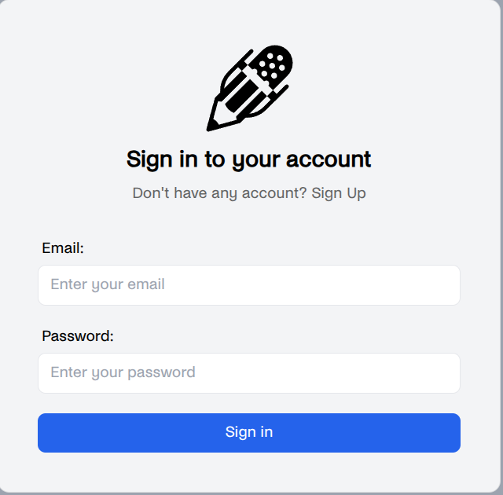
USER REGISTERATION
BLOG APPLICATION SNAPSHOTS
Login with registered email and password
Manages session securely using Appwrite
Error handling for invalid credentials
Redirects users to dashboard/home on success

Slide 11
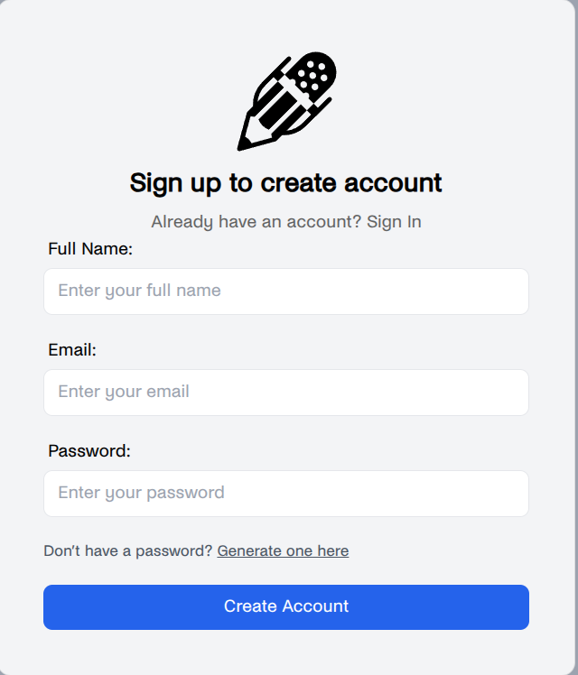
USER LOGIN
Secure signup system using Appwrite Authentication
Validates user inputs: name, email and password
Includes email verification for authenticity
Styled with Tailwind CSS for responsiveness

Slide 12
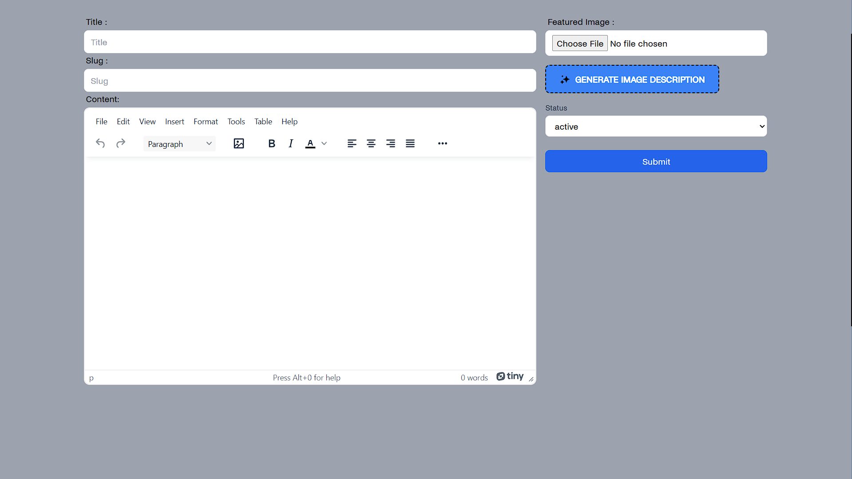
POST UPLOADER
Developed and tested the user registration & login system
Integrated backend authentication using Appwrite
Designed and implemented the blog post uploader
Focused on form validation, session management and UI responsiveness

Slide 13
Software Engineering Model Used ( Iterative Model)
The Iterative Model was used to develop the blog web application. This model emphasizes repeated cycles of development and refinement, making it ideal for evolving user needs.
Development Phases:
1. Initial Planning – Core requirements identified (e.g., user login, post creation).
2. First Iteration – Developed and tested MVP (basic post & view functionality).
3. Subsequent Iterations – Added features: comments, AI automated description.
4. Testing & Feedback – Each version tested and refined.
5. Final Deployment – Fully functional blog with all features integrated.

Slide 14
Software Requirements
Category | Requirement
Operating System | Windows 10/11, macOS, or any Linux distro
Code Editor/IDE | Visual Studio Code (VS Code)
Frontend | React.js (with libraries like React Router, React Hook Form, etc.)
Styling | Tailwind CSS / CSS Modules
Backend | Appwrite – for Authentication
Database | Appwrite's built-in NoSQL Database
Package Manager | Node.js with npm
Browser | Microsoft Edge / Google Chrome / Firefox
APIs/Utilities | Appwrite SDK (JavaScript), TinyMCE (for rich text editing), etc.
Version Control | Git & GitHub
Tools | Google Gemini (for image description AI, if integrated)

Slide 15
Hardware Requirements
Component | Minimum Requirement | Recommended
Processor (CPU) | Dual-core (Intel i3 / AMD equivalent) | Quad-core or higher (Intel i5/i7 or AMD Ryzen 5+)
RAM | 4 GB | 8 GB or more
Graphics | Integrated GPU | Dedicated GPU (for better performance, not necessary)
Internet Connection | Required for accessing Appwrite & hosting | Stable broadband recommended

Slide 16
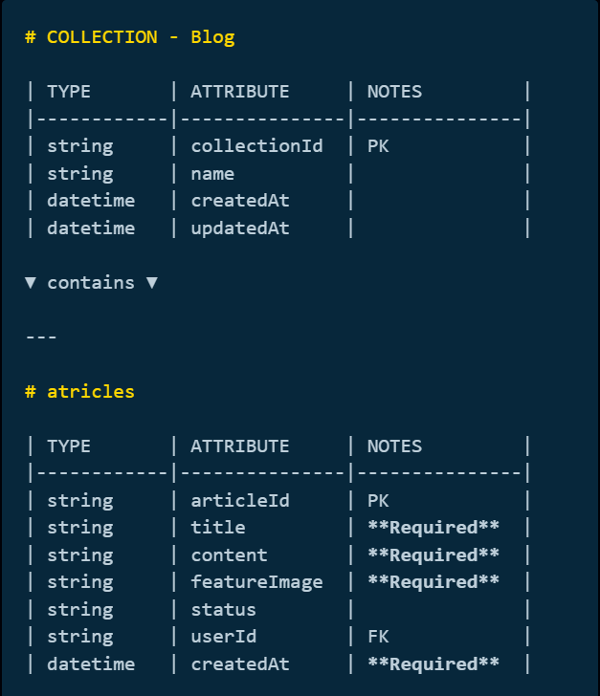
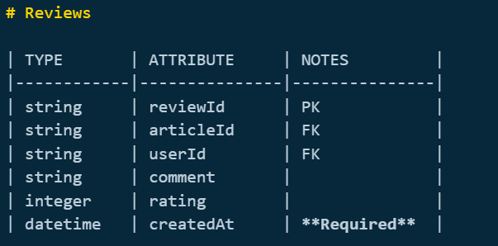
DATABASE STUCTURE

Slide 17
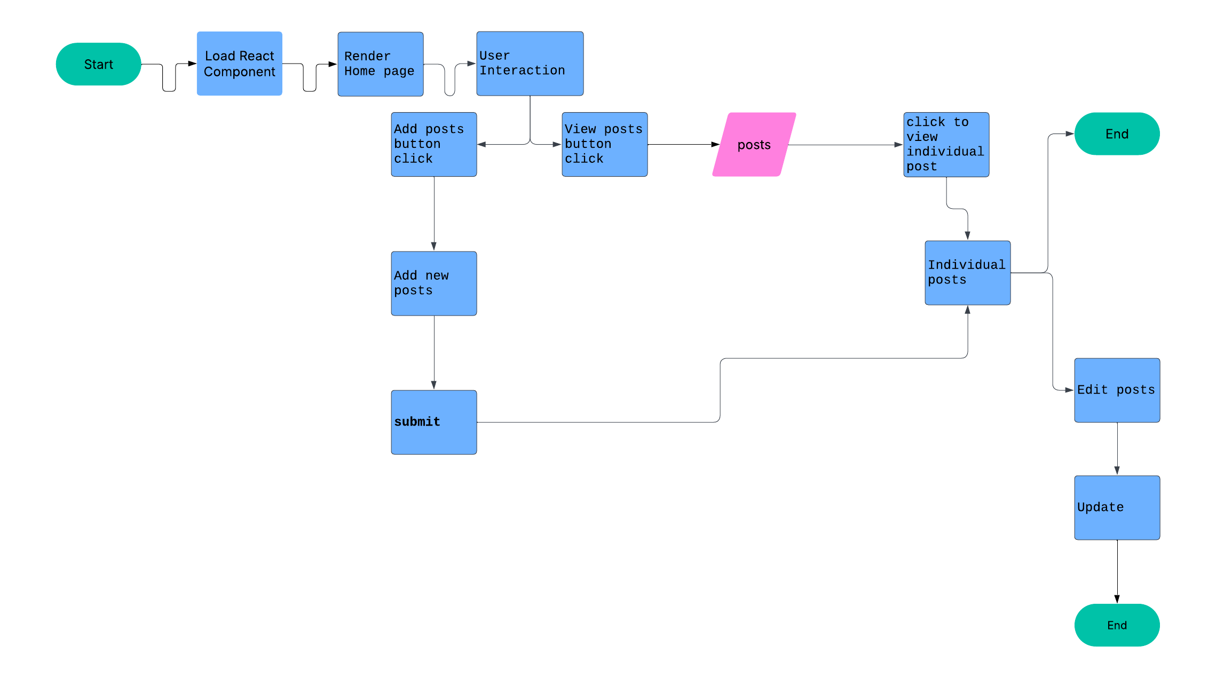
workflow

Slide 18
CONCLUSION
In this project we have made an attempt to see the result of our study an throughout this project, our team has diligently worked to create a digital space that mirrors the energy and uniqueness of a blog application .
Overall Outcomes of the project
Overall, The Blog Application development project embodies a commitment to redefining how stories are created, shared, and experienced in the digital world. Our focus on blending cutting-edge technology with intuitive design sets a new benchmark for modern blogging platforms.
Throughout this presentation, we explored the innovative features and thoughtful design elements that make this application stand out in today's competitive landscape of digital content platforms.

Slide 19


